Slide 1
Artisan Summit
Pitching Products & Telling your Story
September 2020

Slide 2
Overview
Meet & Greet
Quoting for Success
Telling Artisan Stories

Slide 3
Meet & Greet

Slide 4
Tradeshow Introductions
What buyers really want to know:
Artisan Groups
Materials
Current customers
Process for QA/ working with artisans
MOQs
Port of Lading
Packaging Information

Slide 5
Quoting for Success

Slide 6
Quoting For Success
Customer Templates
Understanding of customer requirements prior to providing a price
Ticketing
Testing
Packaging
Logistics
Samples Requirements
Attention to detail
Clarity in images and size details

Slide 7
Quote Sheet Template
Image | SKU # | SKU Description | Dimensions ( inch) | Color/FInish | Materials | Vendor | COO | MOQ | FC | MCDL (master inner) | Packaging Details | Testing Included? | Port of Lading
 | 728747 | Modern Weave Storage Basket White Wash | 14"w x 17"d x 9"h | White Wash | Rattan Peel | Best Basket Co. | Philippines | 200 | $11.78 | 1/1 | 100 PSI outer carton, inner paper wrapping, 1 color print kraft hangtag | Full WSI product and transit testing fees included | Manila

Slide 8
Telling Artisan Stories

Slide 9
Telling Artisan Stories

Slide 10
Telling Artisan Stories

Slide 11
Telling Artisan Stories

Slide 12
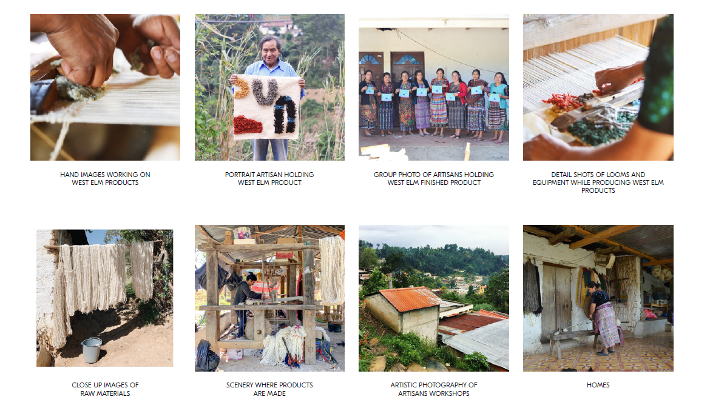
Photography Direction

Slide 13
Thank you! Questions?

